Slide 1



Making better conservation decisions
Jeffrey Hanson
jeffrey.hanson@uqconnect.edu.au
jeffrey-hanson.com

Slide 2


Acknowledgements
Amanda Martin
Angela Brennan
Brandon Edwards
Caitlyn Proctor
Emma Hudgins
Matthew Strimas-Mackey
Iadine Chadès
Hugh Possingham
Jaimie Vincent
Jenny McCune
Joseph Bennett
Josie Hughes
Lenore Fahrig
Nina Morell
Peter Arcese
Richard Schuster
Richard Pither

Slide 3
Now
Biodiversity
Status quo
2000
Future

Slide 4
Now
How do we
get here?
Biodiversity
Status quo
2000
Future

Slide 5
How can we get a better conservation decision?
(1) Better algorithms
(2) Better data
(3) Better surrogates

Slide 6



Ecological surveys
Distribution maps
Priority areas
Biodiversity
2000
Future
Data
Information
Plan
Outcome
Objectives
Constraints

Slide 7
Ecological surveys
Distribution maps
Priority areas
Biodiversity
2000
Future
Data
Information
Plan
Outcome
Better
algorithms
Better
outcome
Objectives
Constraints

Slide 8
Reserve selection
Features
Notes:
- not all remaining habitat can be preserved
- achieve conservation objectives for minimal cost
- modern systematic conservation planning primarily focusses on representing species
- however, this ignores intra-specific biodiversity
8

Slide 9
Reserve selection
Planning units

Slide 10
Reserve selection
?
?
?
?
?
?

Slide 11
Reserve selection

Slide 12





Heuristic
algorithm
Meta-heuristic
algorithms
Exact
algorithms
Estimate of best quality
Quality
Different
solutions
Different
solutions
Different
solutions

Slide 13

prioritizr: Systematic conservation prioritization in R
It’s an R package (yes, this is good)
First released on CRAN in 2016
Highly flexible interface
Supports tabular and GIS data formats
Supports multiple zones/actions
Powered by open source and commercial exact algorithm solvers
Want to see a worked example? Ask me afterwards during question time
prioritizr.net

Slide 14
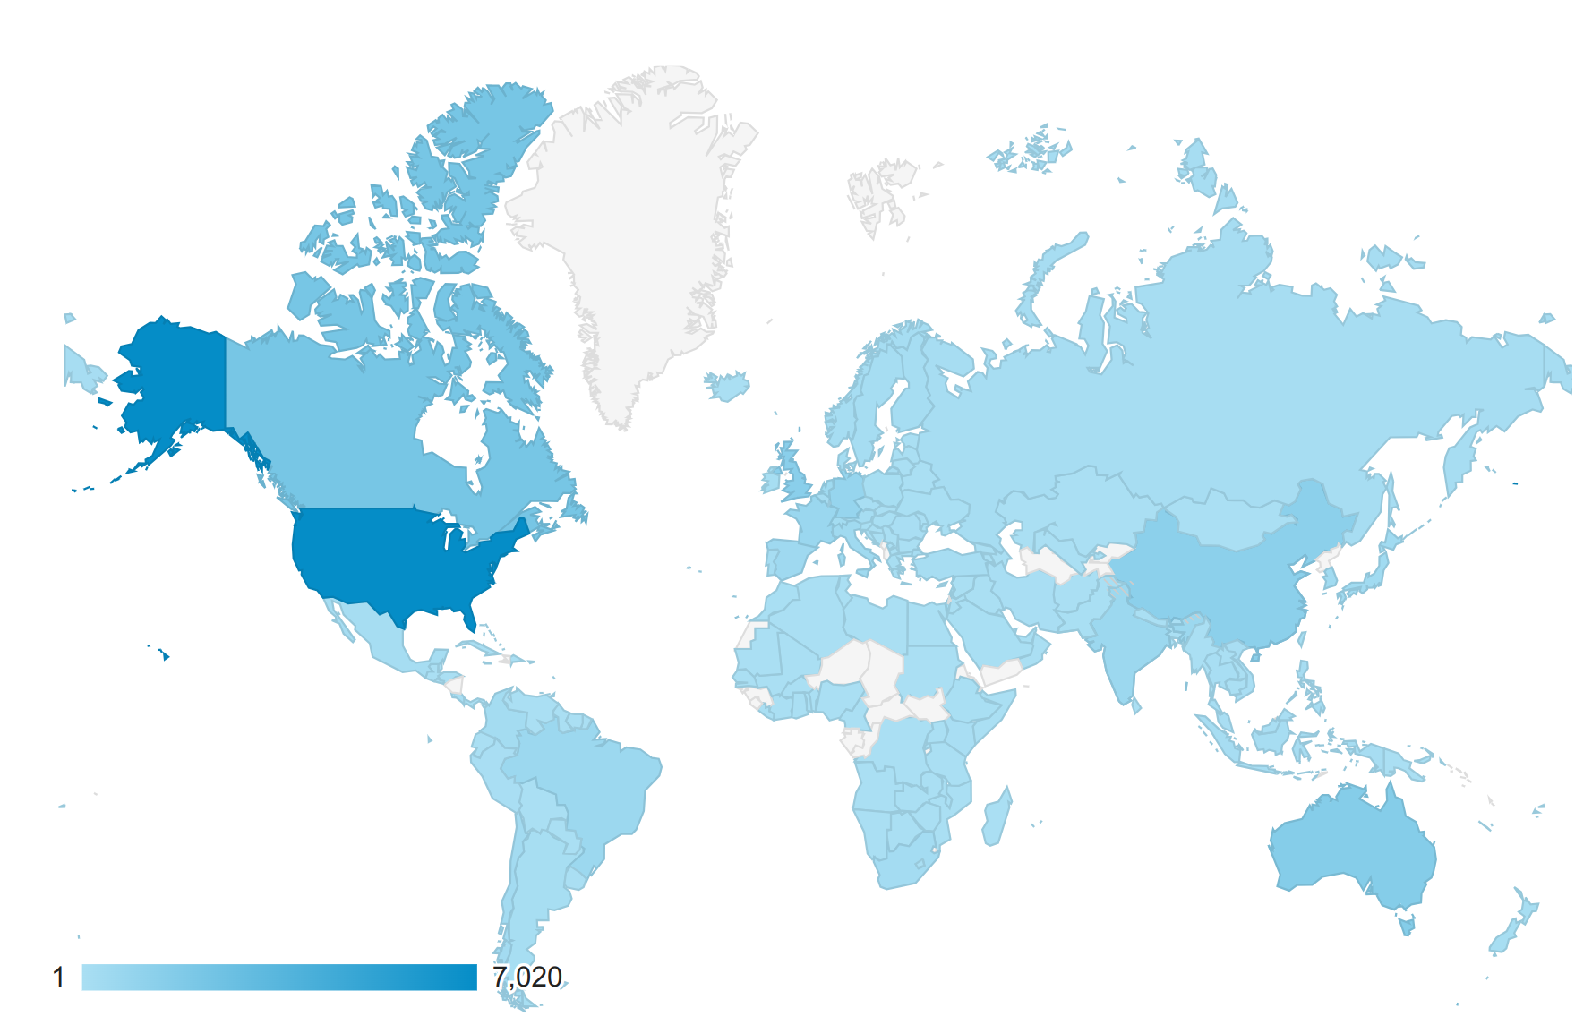
Who uses it?
Web site visitors
85 scientific publications used it for generating prioritizations
Conservation organizations: Nature conservancy Canada, UN Biodiversity Lab, Waitt Institute
Helped inform planning for Government of Monsterrat, Scottish Government, US Geological Survey, Governments of the Maldives and the Federated States of Micronesia

Slide 15
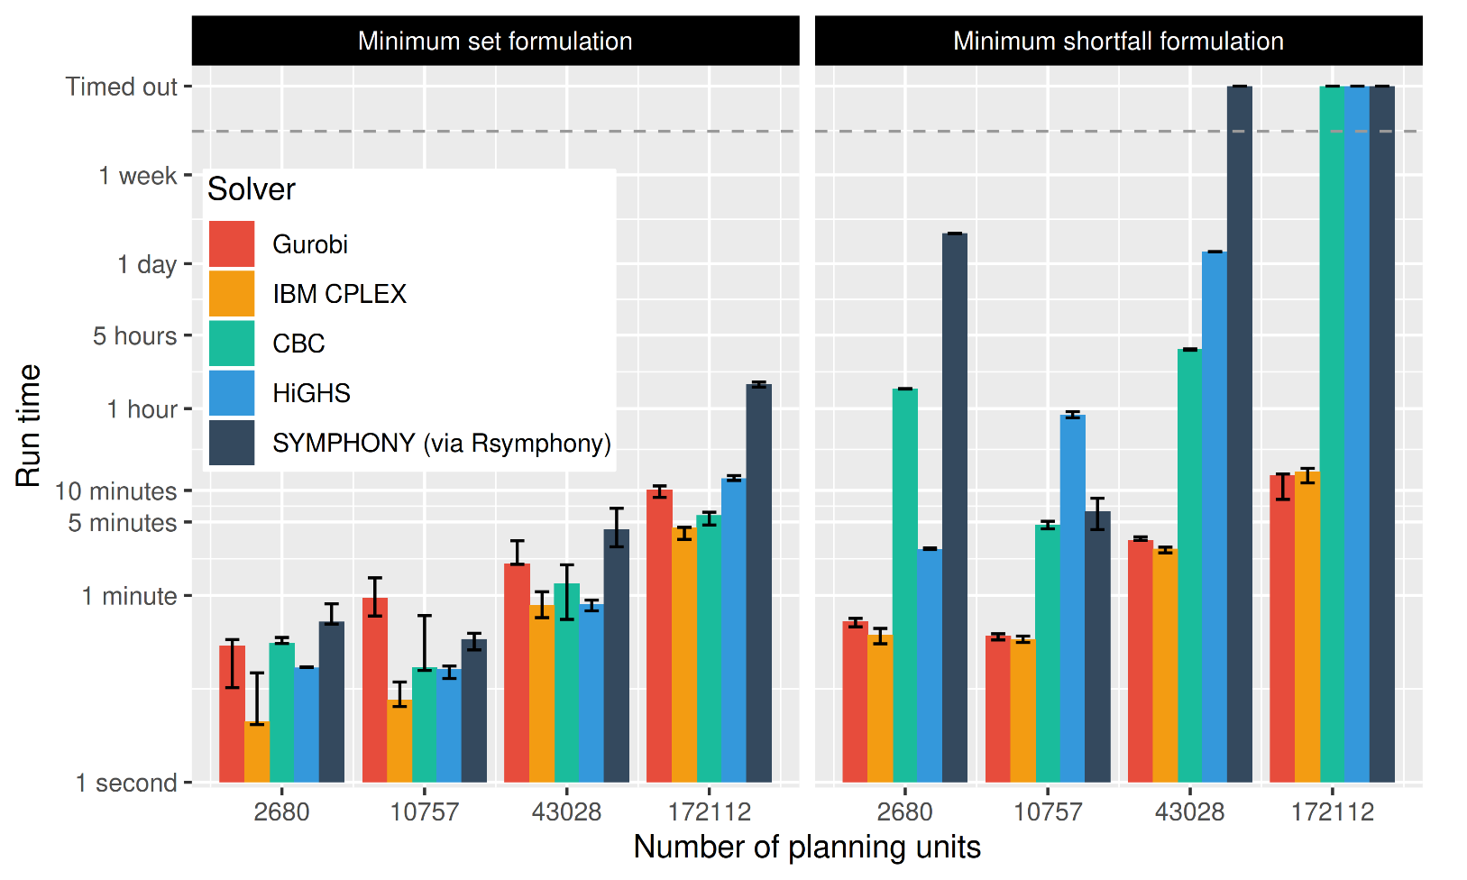
Solve problems pretty quickly!
Notes: 396 features, no planning units locked in or out, prioritizations ≤ 10% from optimality
Hanson et al. under review

Slide 16
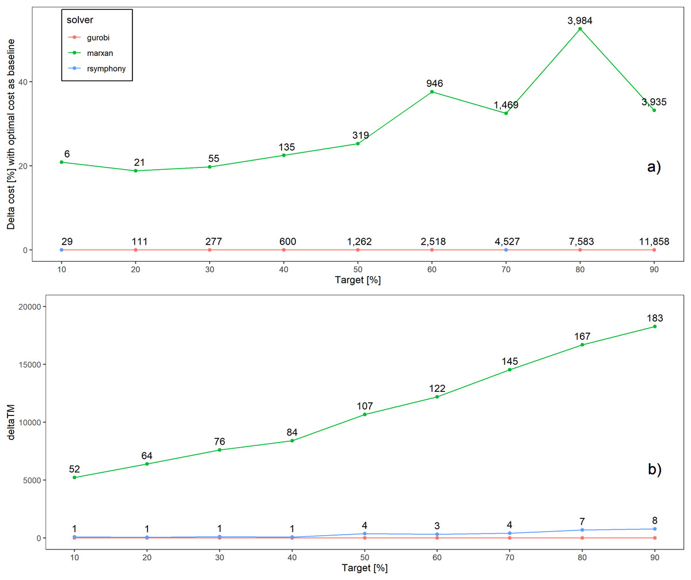
Better solutions
Schuster et al. 2020 PeerJ

Slide 17
Faster too
183x slower
52x slower
Time difference
Schuster et al. 2020 PeerJ

Slide 18
How can we get a better conservation decision?
(1) Better algorithms
(2) Better data
(3) Better surrogates

Slide 19
Ecological surveys
Distribution maps
Priority areas
Biodiversity
2000
Future
Data
Information
Plan
Outcome
Objectives
Constraints

Slide 20
Ecological surveys
Distribution maps
Priority areas
Biodiversity
?
?
?
?
?
?
2000
Future
Data
Information
Plan
Outcome
More
surveys
Better
models
Better
management
Better
outcome
Objectives
Constraints

Slide 21
Ecological surveys
Distribution maps
Priority areas
Biodiversity
?
?
?
?
?
?
?
?
?
?
?
?
2000
Future
Data
Information
Plan
Outcome
More
surveys
Better
models
Poorer
management
Worse
outcome
Objectives
Constraints
Less funding

Slide 22
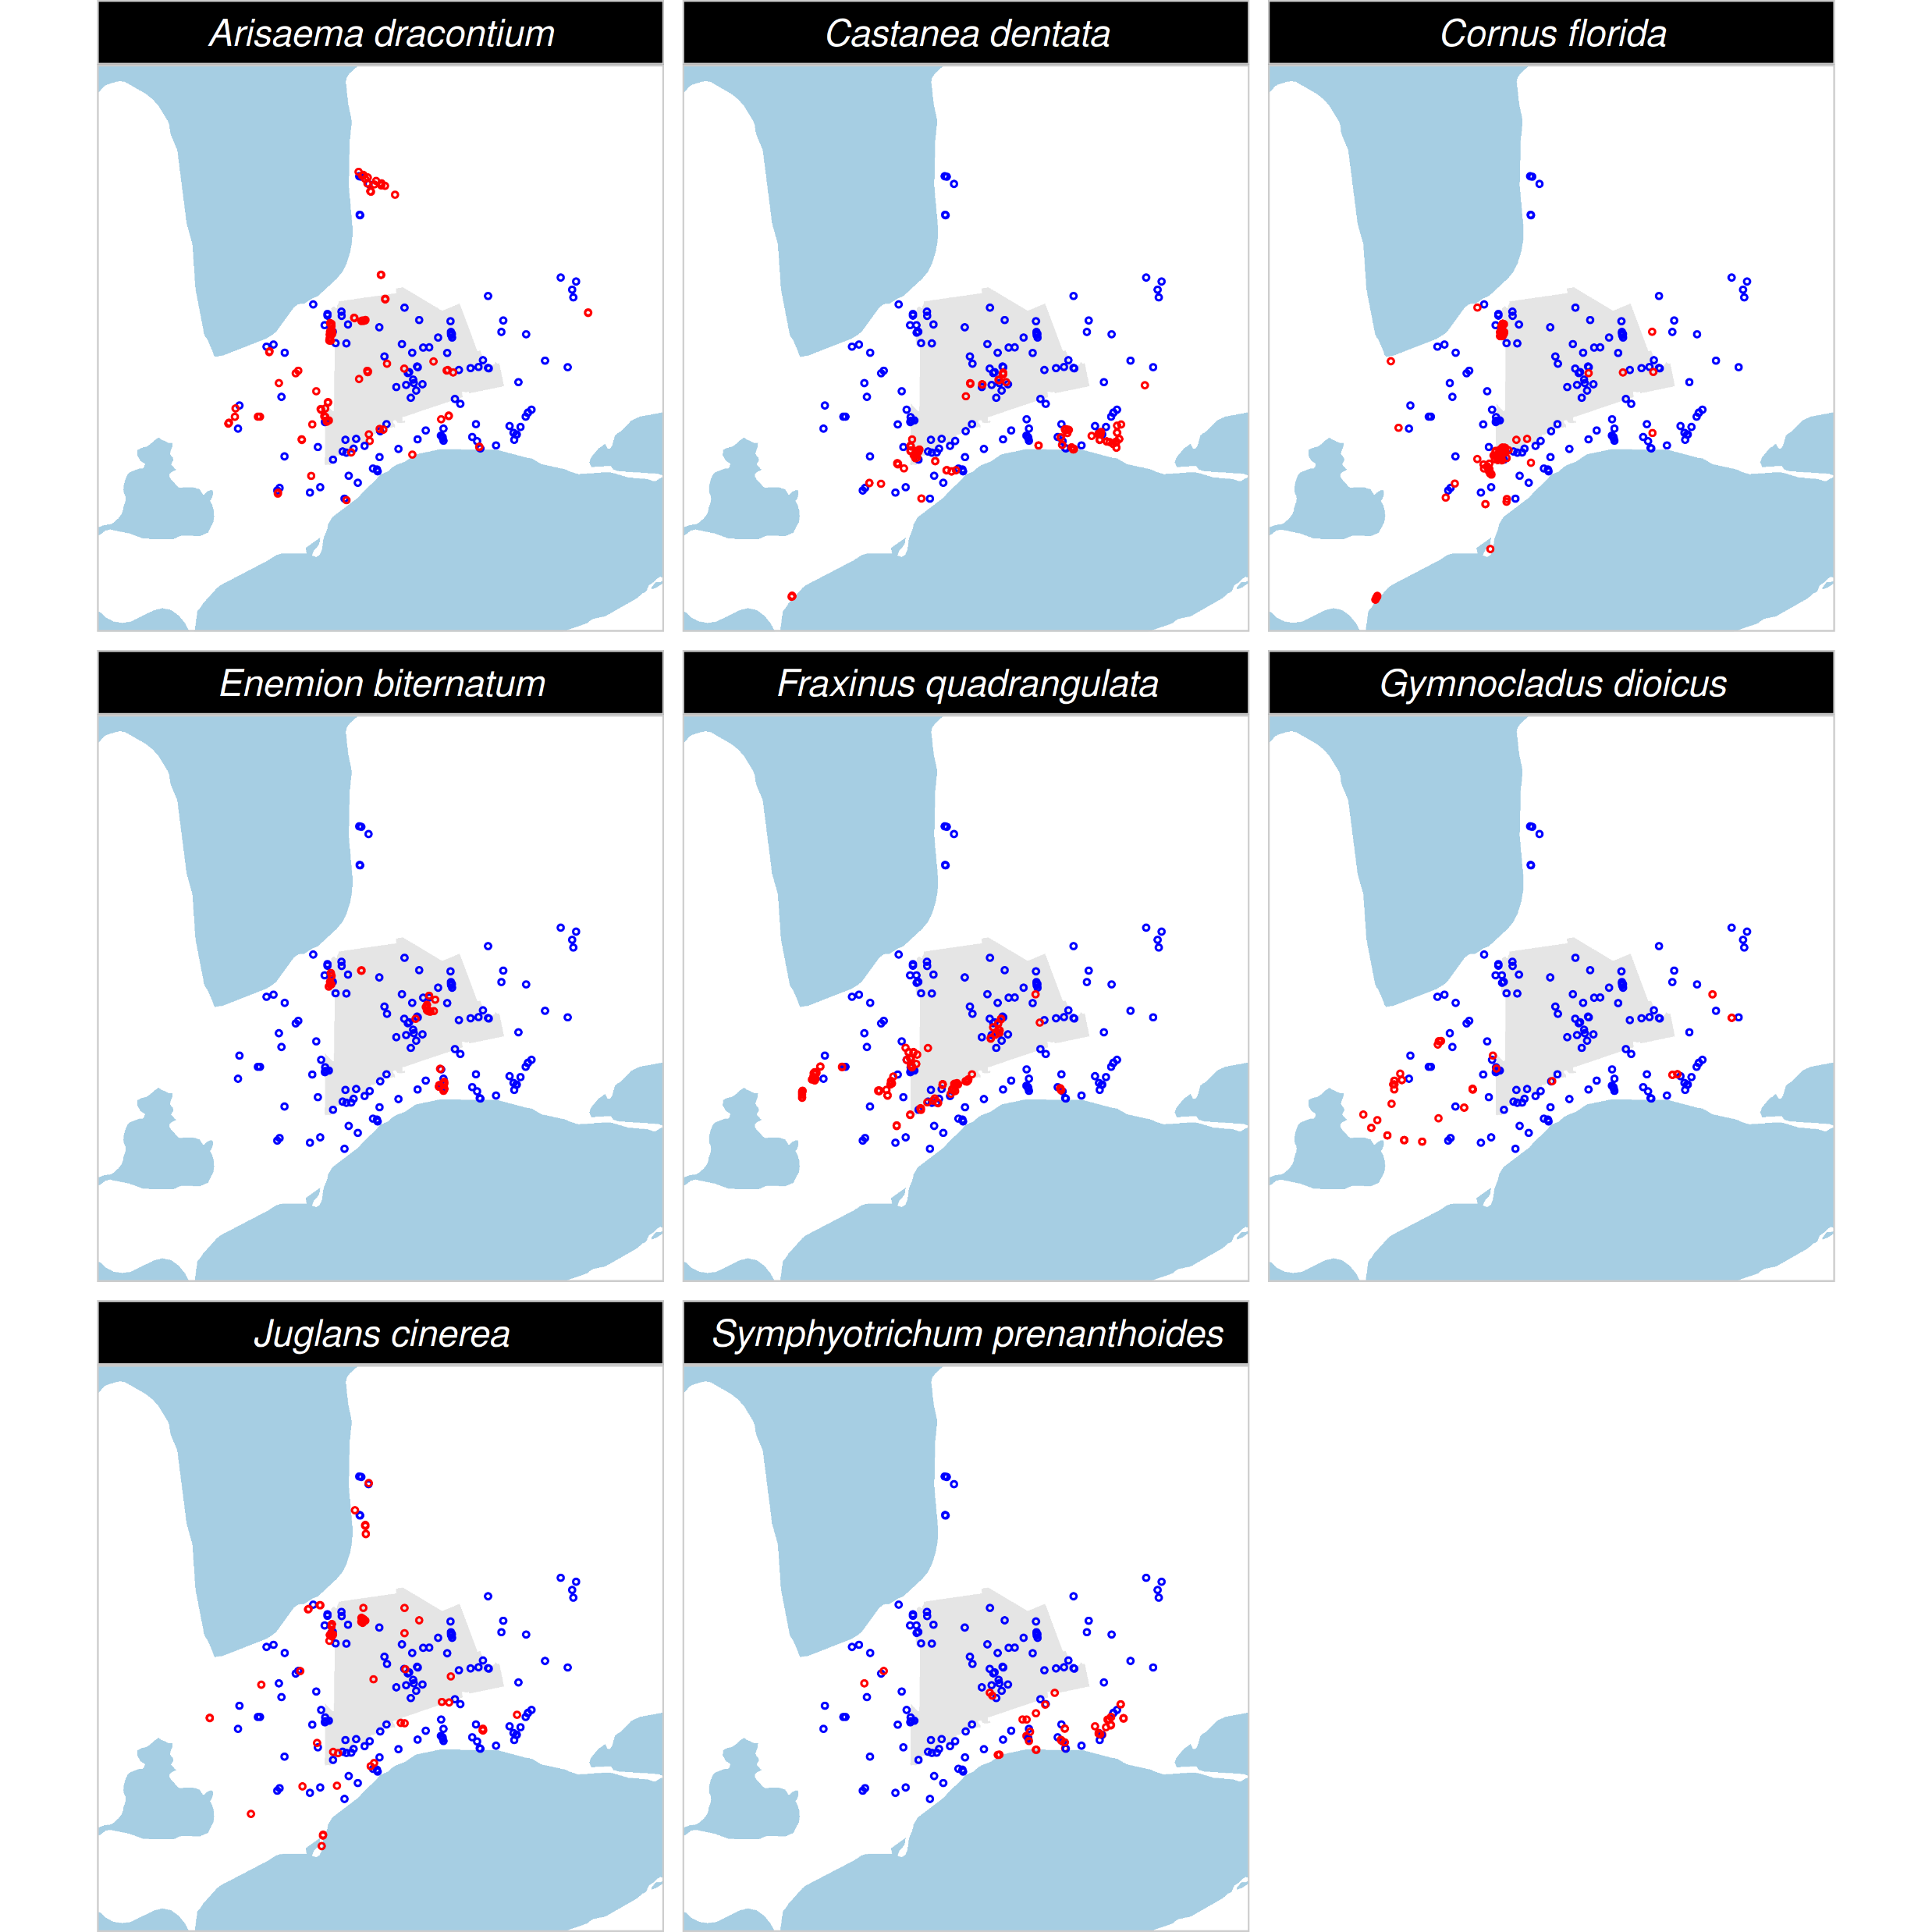
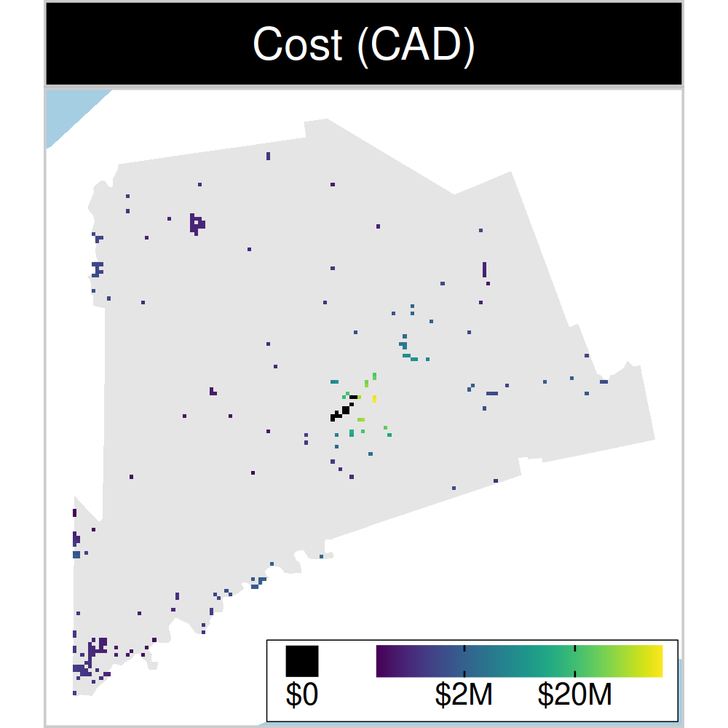
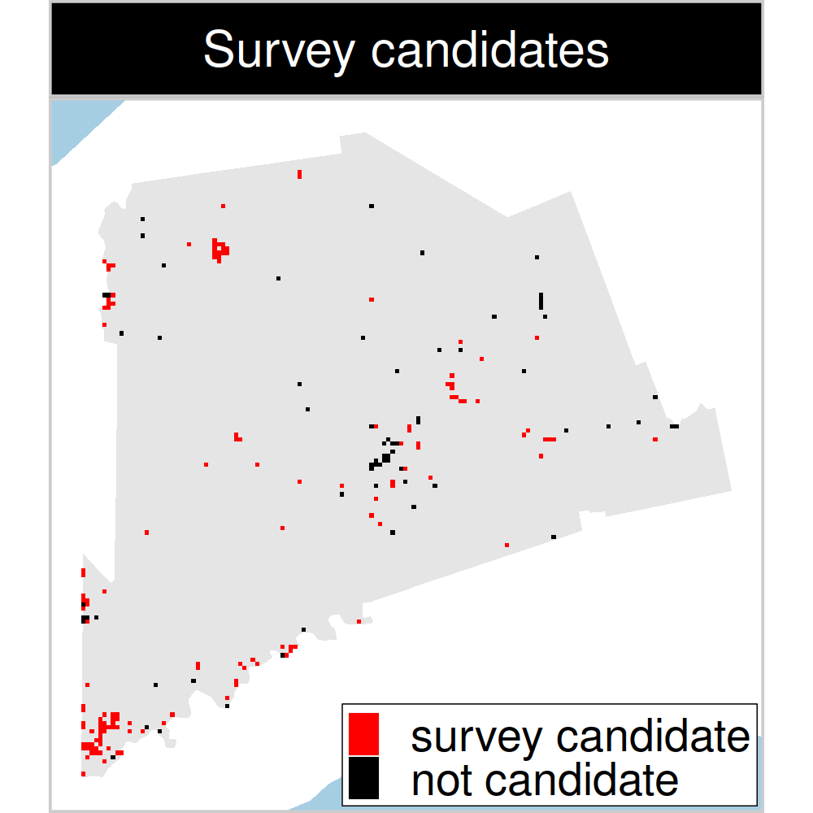
Study system: Middlesex county, Canada
199 places that could
potentially be acquired for
protected area establishment
143 places that could potentially be surveyed to
improve existing data
8 imperiled plant species
Hanson et al. 2023 J. Appl. Ecol
Notes:
22

Slide 23
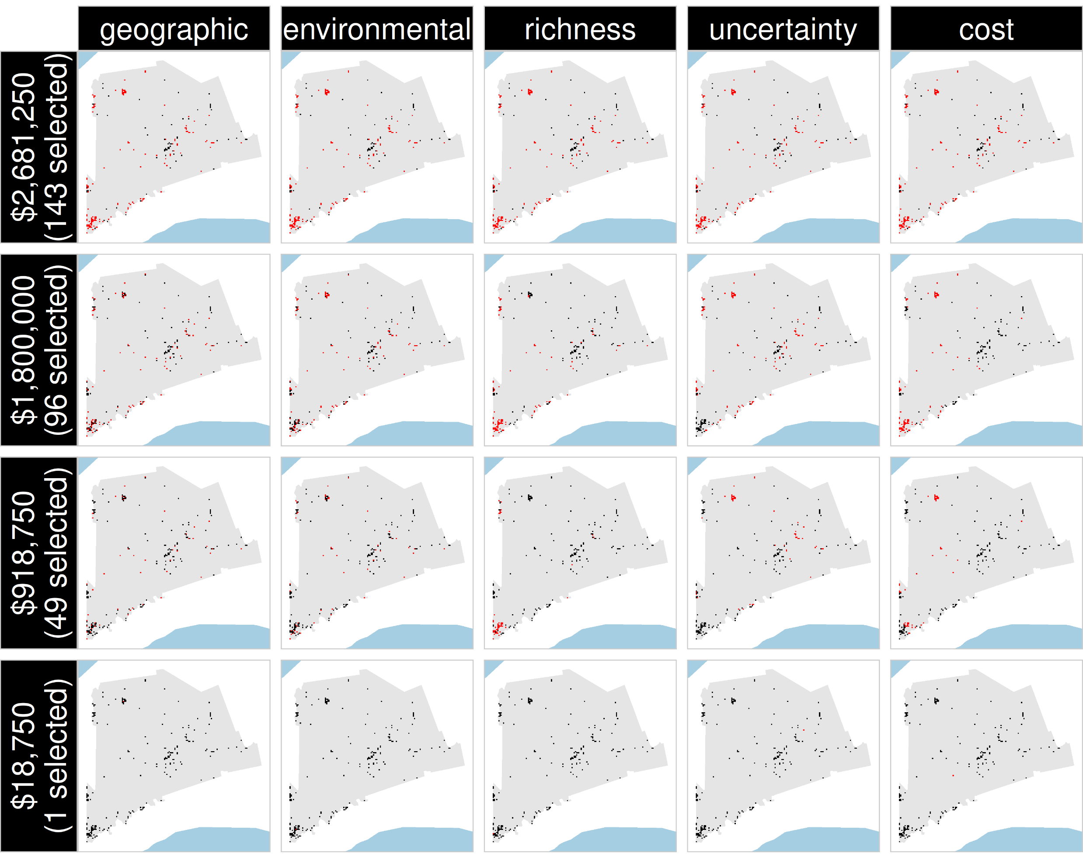
Selected
for survey
Number of places selected for surveys
(amount of funds allocated for collecting extra data)
NOT selected
for survey
Different approaches for designing survey schemes
Hanson et al. 2023 J. Appl. Ecol

Slide 24
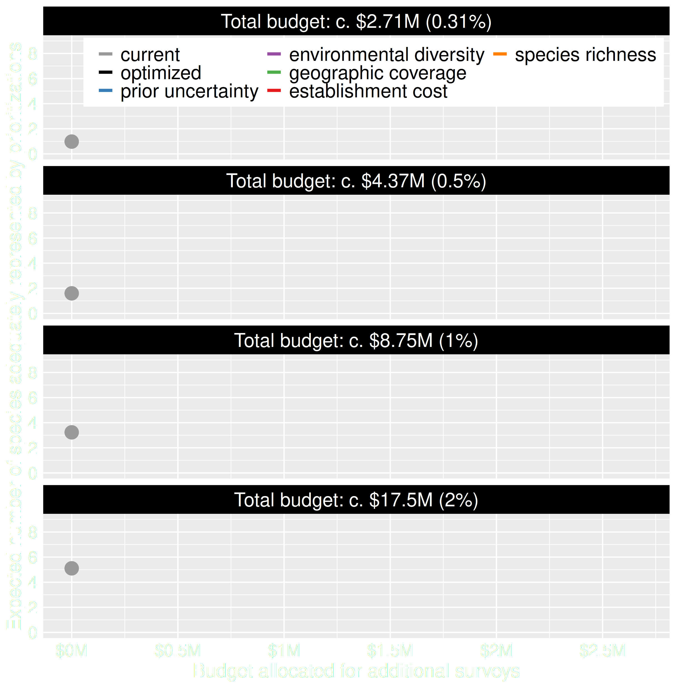
Value of information
Existing data leads to positive outcomes
More budget means better outcomes
Hanson et al. 2023 J. Appl. Ecol

Slide 25
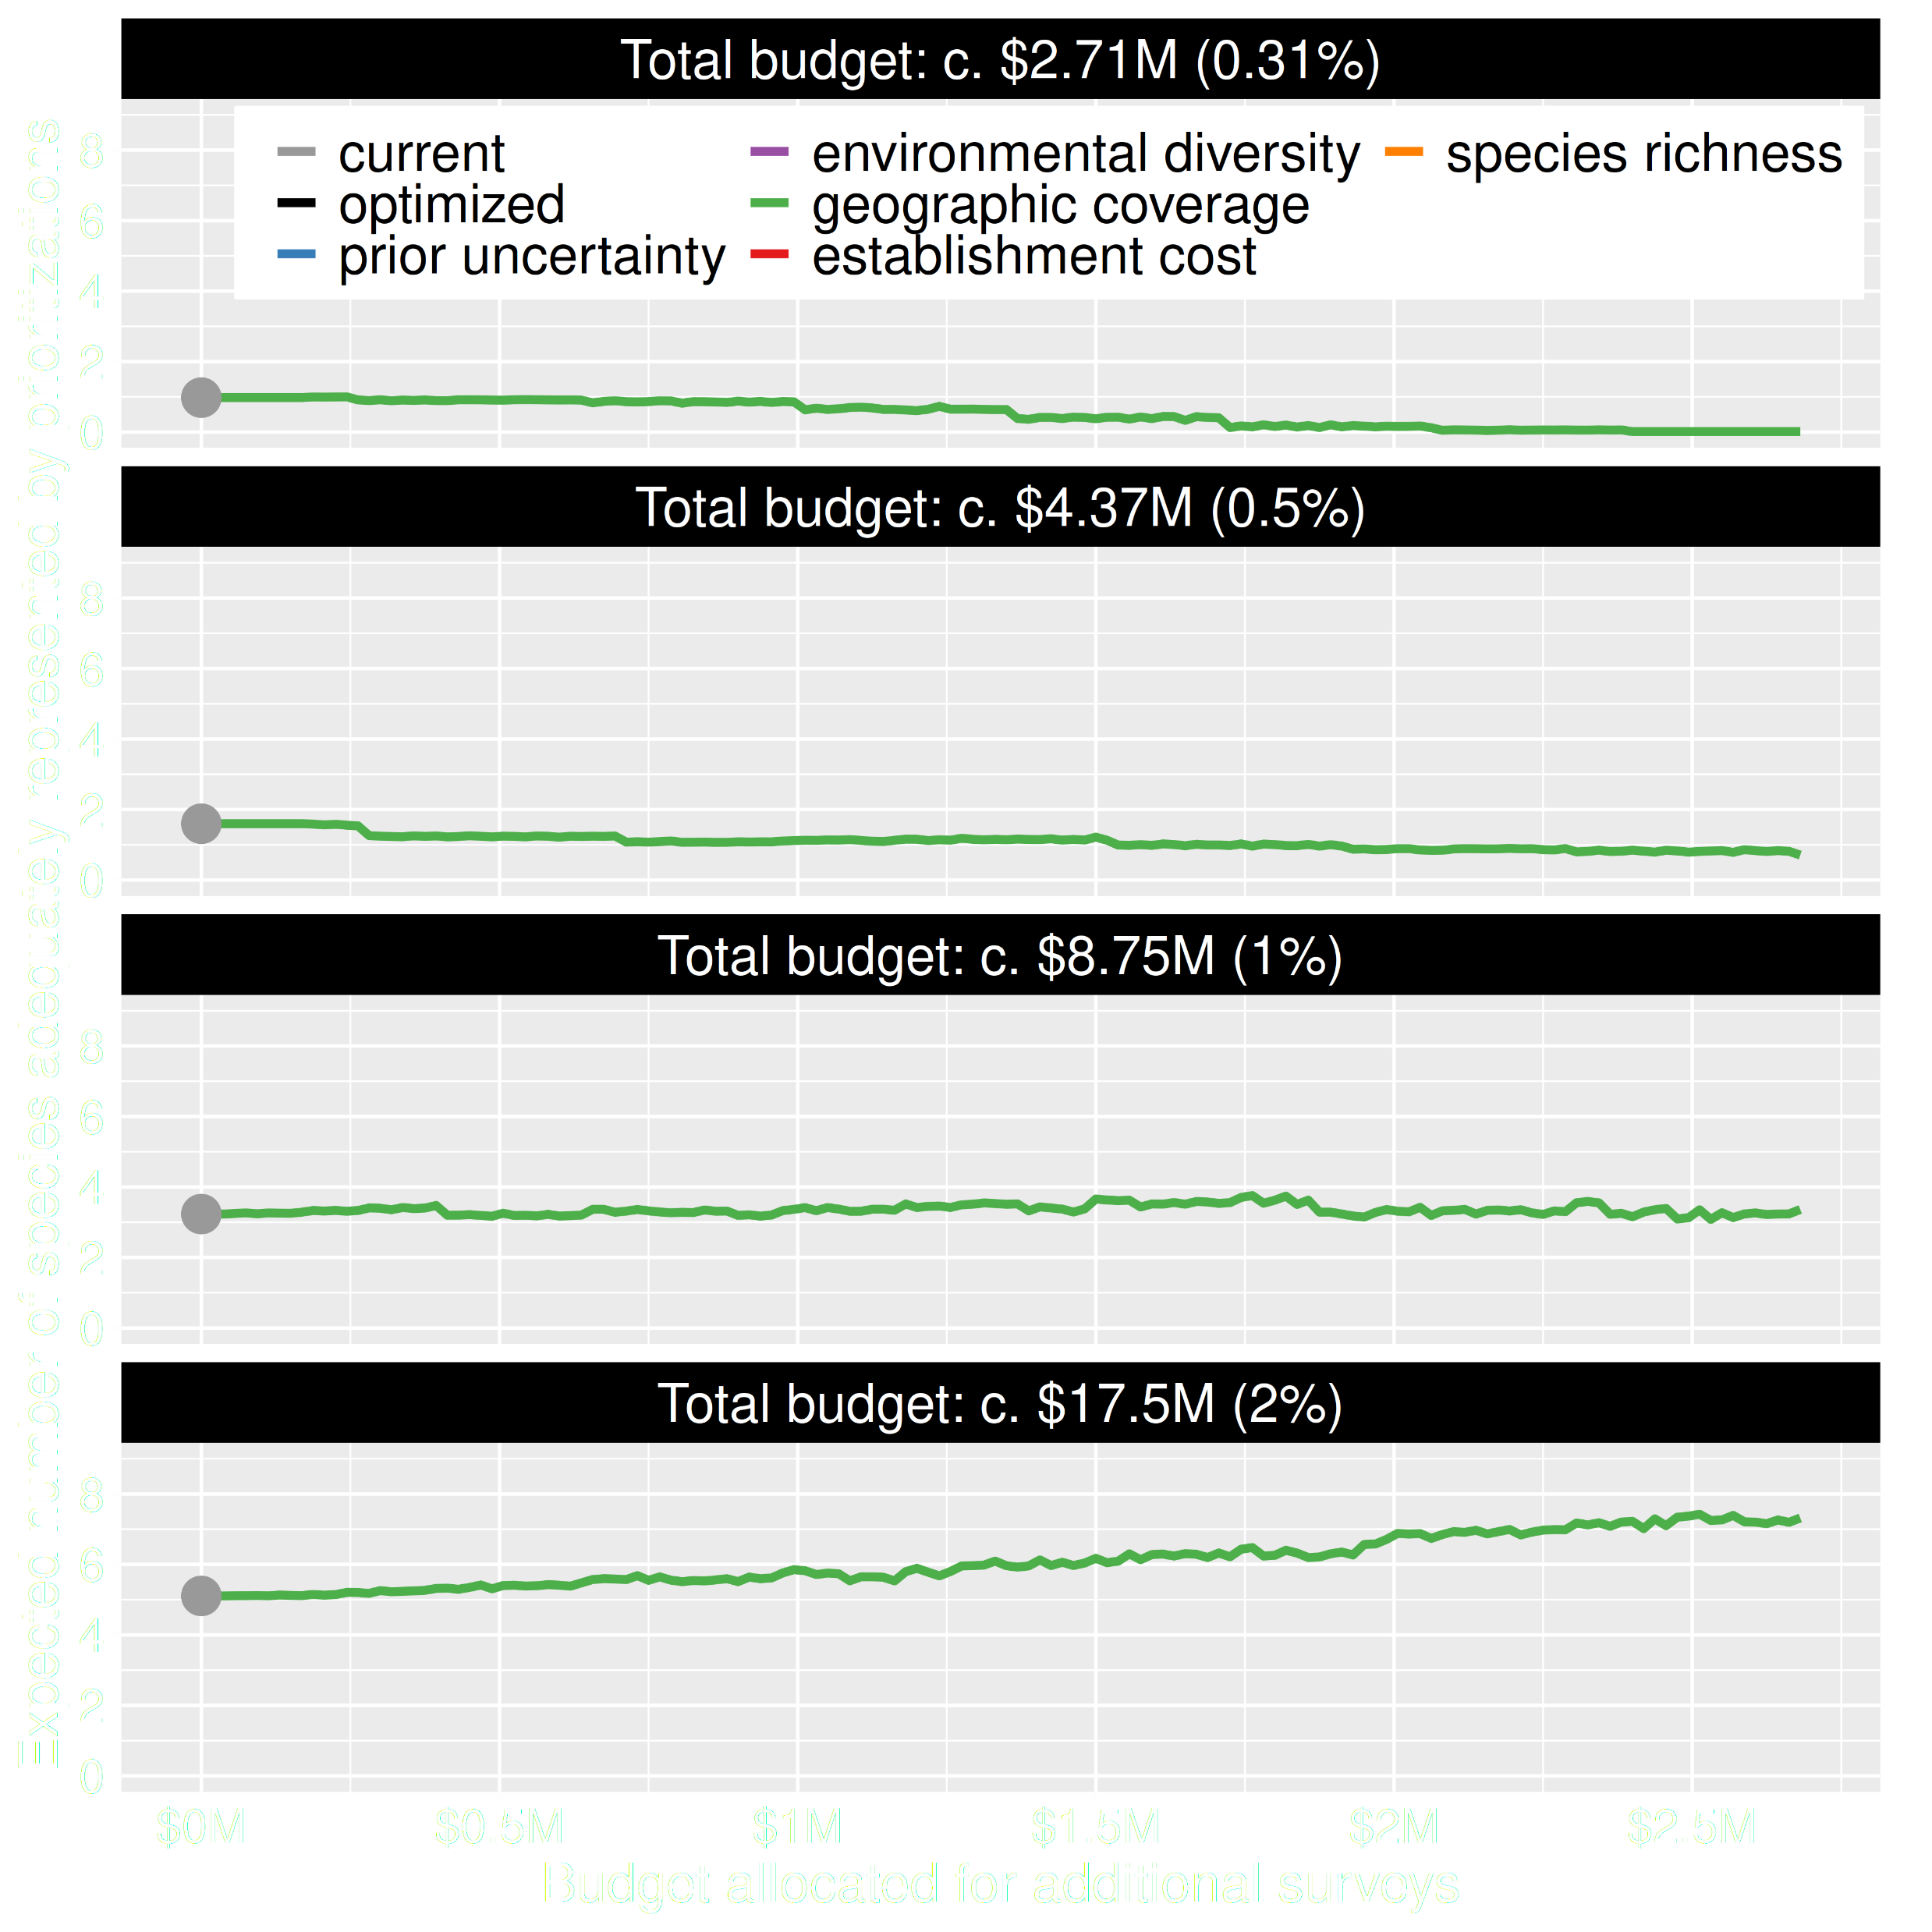
Value of information
Allocating funds for gathering more data can mean worse outcomes
Allocating funds for gathering more data can mean better outcomes too
Hanson et al. 2023 J. Appl. Ecol

Slide 26
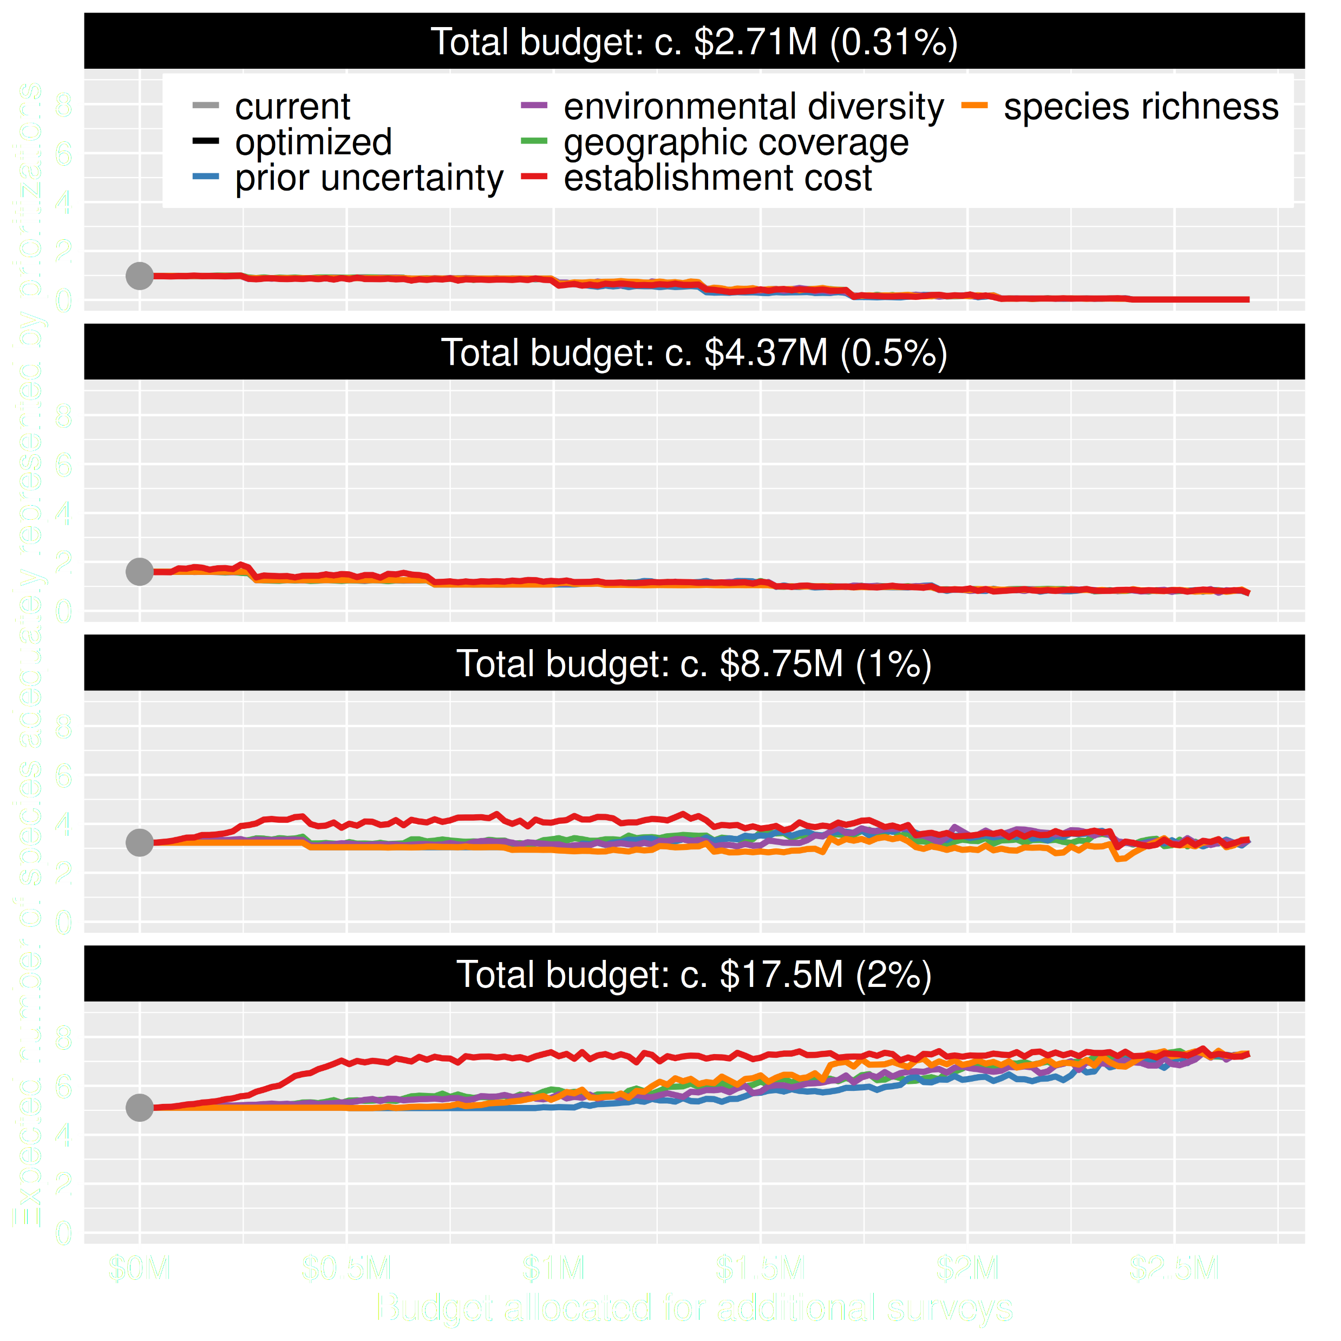
Value of information
Conventional approaches for gathering additional evidence have different performance
Performance of these approaches depends on available funds
All of them could lead to lead to worse outcomes
Hanson et al. 2023 J. Appl. Ecol

Slide 27
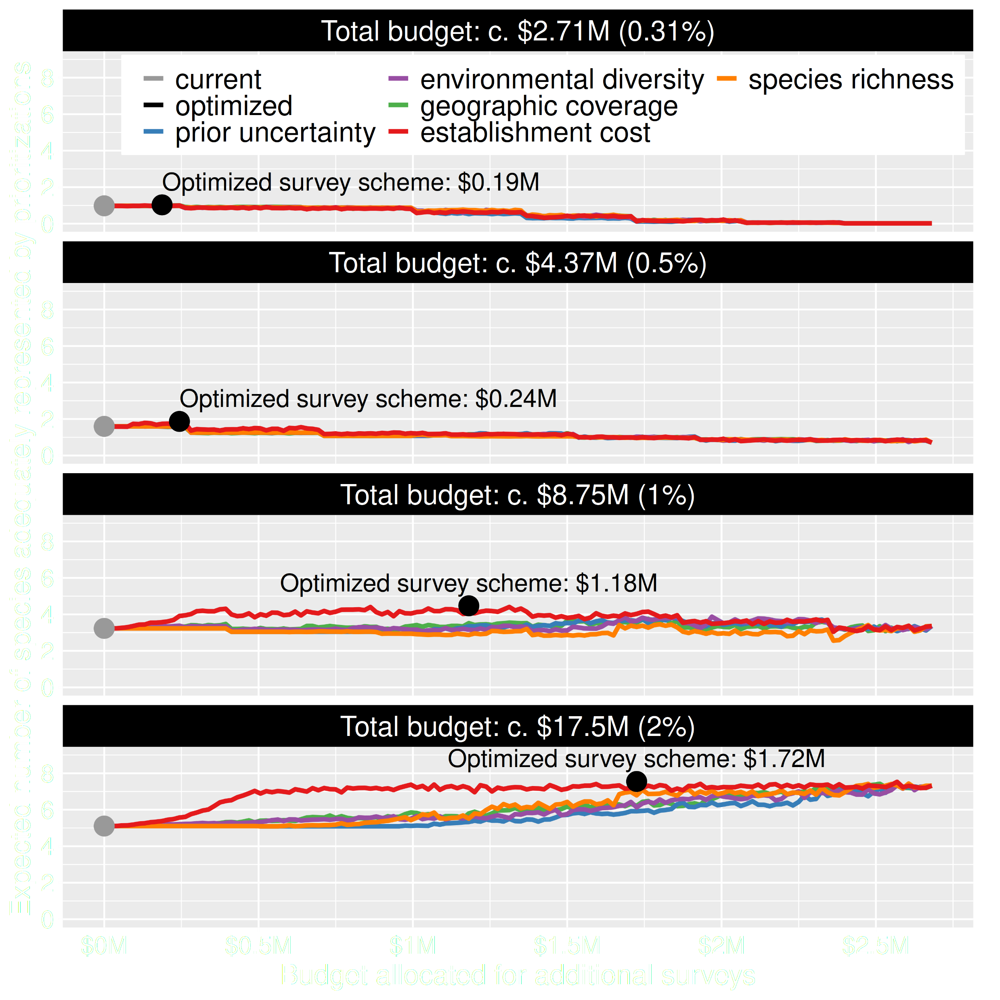
Value of information
Directly maximizing return on investment is best method for additional data
This considers objectives and constraints that underpin conservation plans and their success
You can do this with: surveyvoi R package
Hanson et al. 2023 J. Appl. Ecol

Slide 28
How can we get a better conservation decision?
(1) Better algorithms
(2) Better data
(3) Better surrogates

Slide 29
Ecological surveys
Distribution maps
Priority areas
Biodiversity
2000
Future
Data
Information
Plan
Outcome
Objectives
Constraints

Slide 30



Connectivity in reserve design
movement of individuals and genes between populations
*all else being equal

Slide 31
Data
Information
Plan
Outcome
Ecological surveys
Distribution maps
Priority areas
Biodiversity
2000
Future
Telemetry
Connectivity

Slide 32
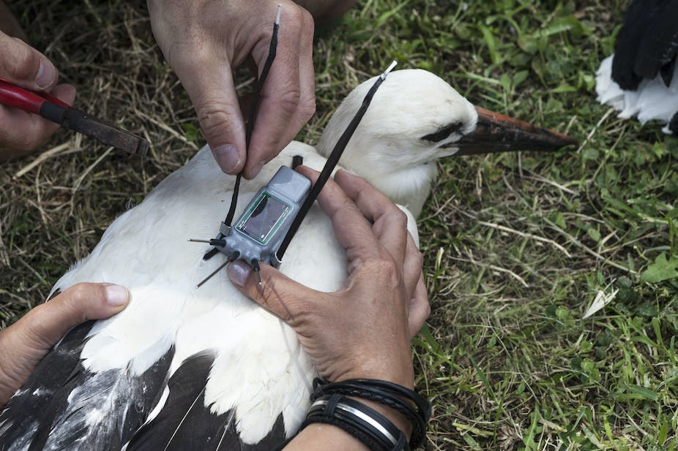
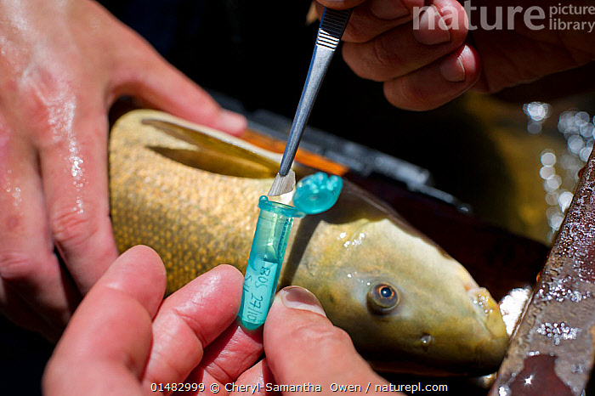
But getting connectivity data is hard
Animal telemetry
Molecular ecology

Slide 33
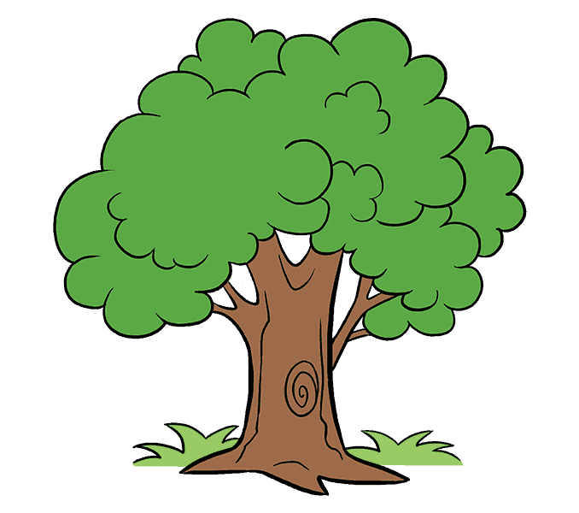
Data
Information
Plan
Outcome
Ecological surveys
Distribution maps
Priority areas
Biodiversity
2000
Future
Surrogate
Surrogate
High connectivity
Low connectivity

Slide 34
Many surrogates are often available,
how do our choices
affect the results?

Slide 35
Rules of thumb for connectivity
More habitat = More connectivity
Total area protected
Species representation
Now
Soon
Later

Slide 36
Rules of thumb for connectivity
More spatial clustering = More connectivity
Boundary length

Slide 37
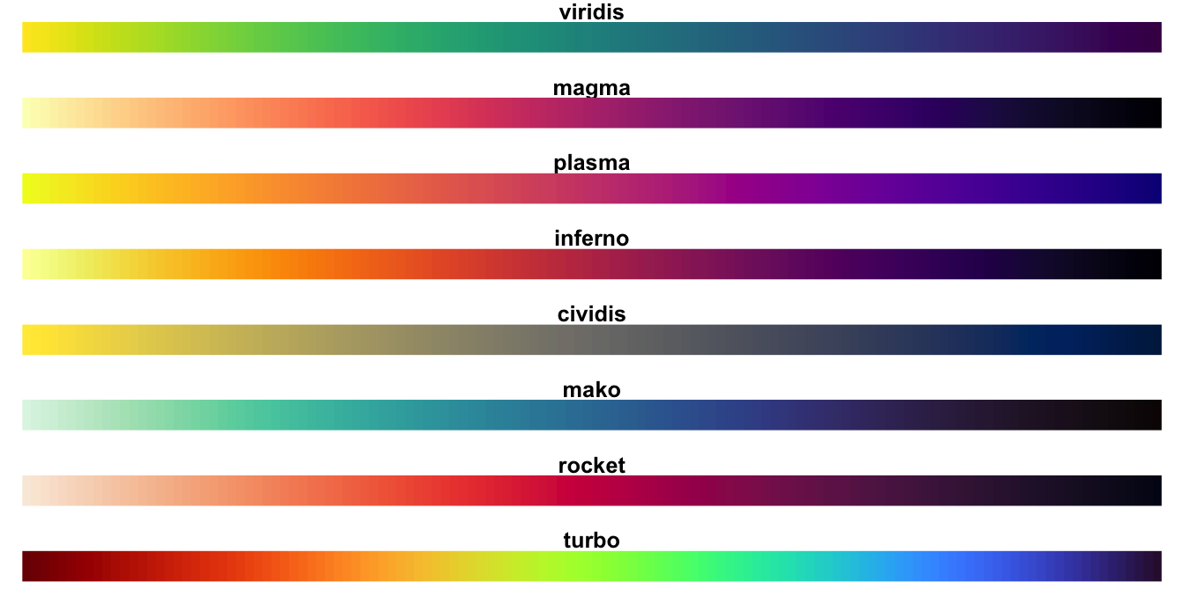
Rules of thumb for connectivity
Protect clusters of low resistance = More connectivity
Human pressure
Naturalness based landscape resistance
Focal species landscape resistance
Habitat heterogeneity
Environmental similarity
High resistance
Low resistance

Slide 38
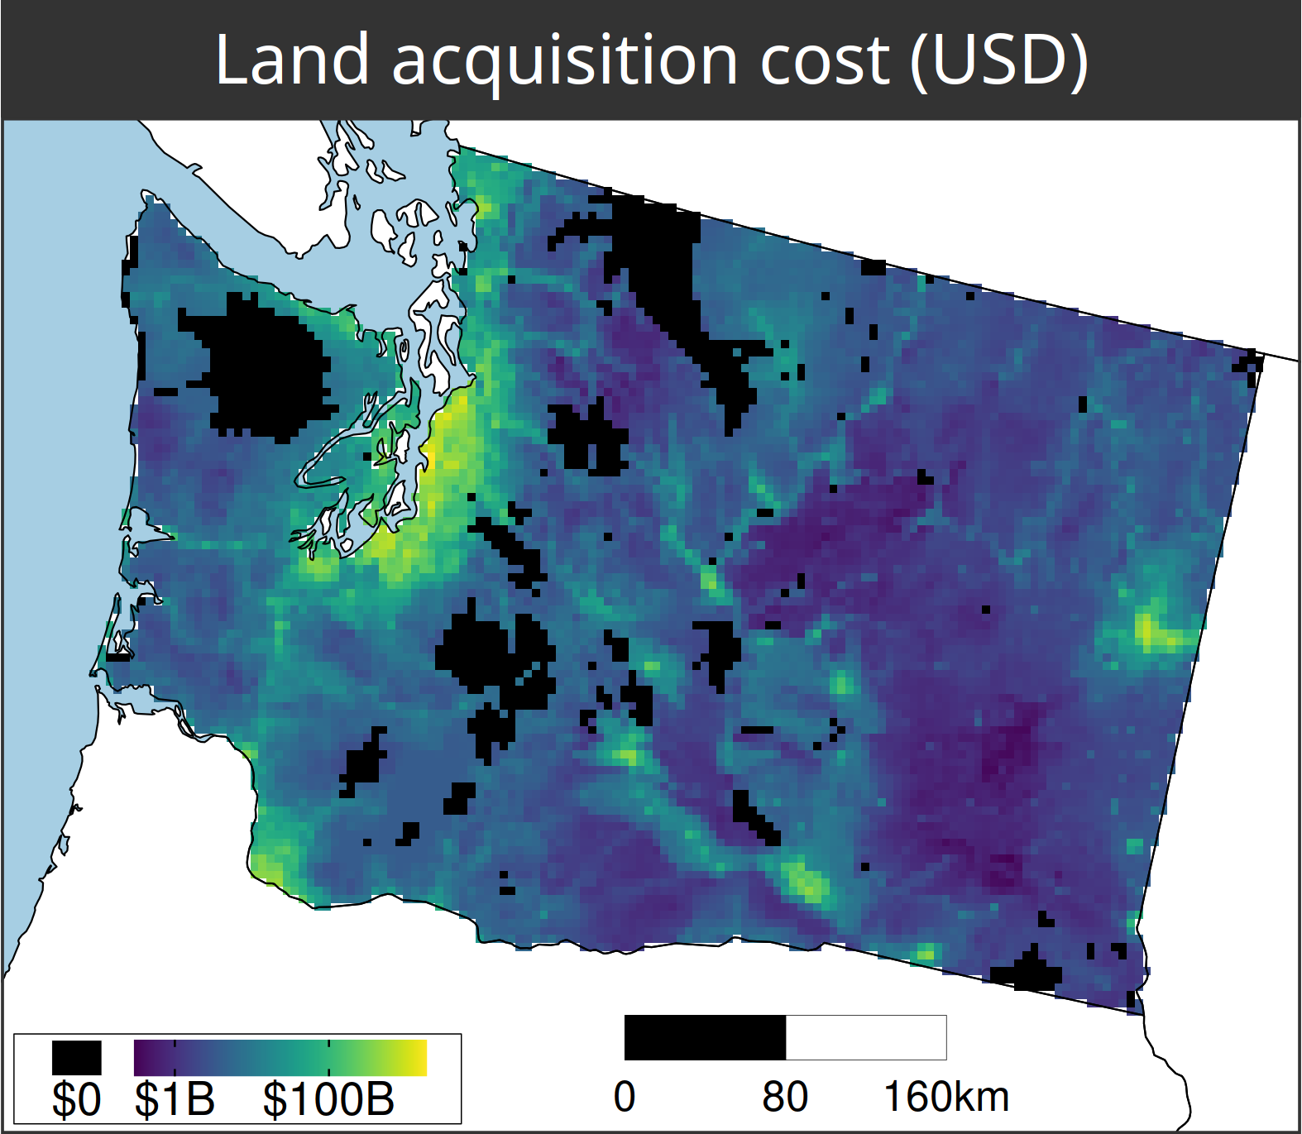
A comparison of approaches for including connectivity in systematic conservation planning
Washington State, USA
261 bird species
Land acquisition costs
Existing protected areas
Multiple land-uses
Multiple eco-systems
Hanson et al. 2022 J. Appl. Ecol

Slide 39
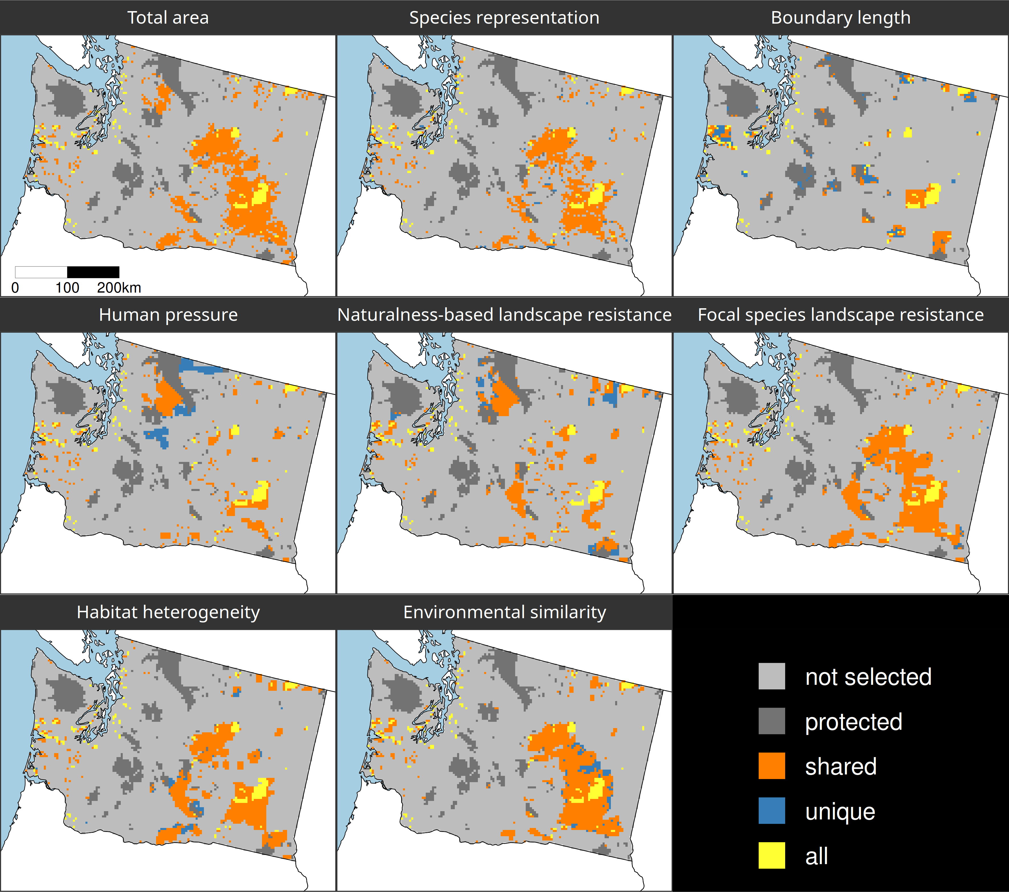
Different connectivity approaches produce different prioritizations
Different connectivity approaches can yield similar prioritizations
Hanson et al. 2022 J. Appl. Ecol

Slide 40
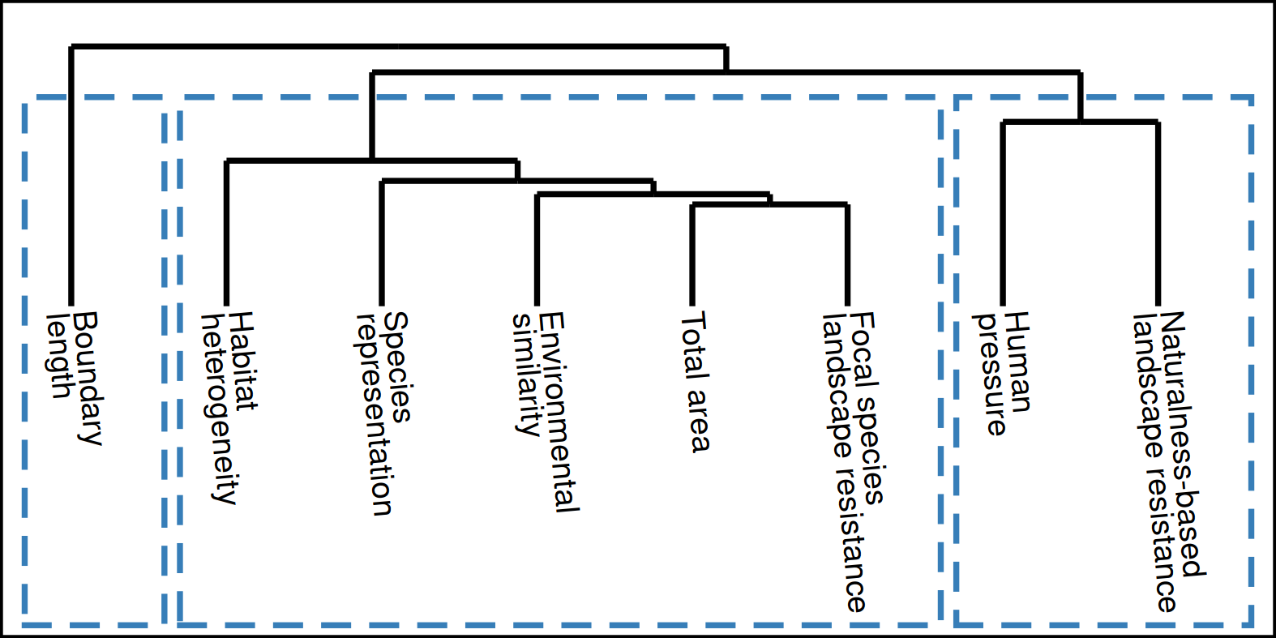
How do the prioritizations compare?
Approach
Habitat-based
Spatial
clustering
Resistance-based
Hanson et al. 2022 J. Appl. Ecol

Slide 41
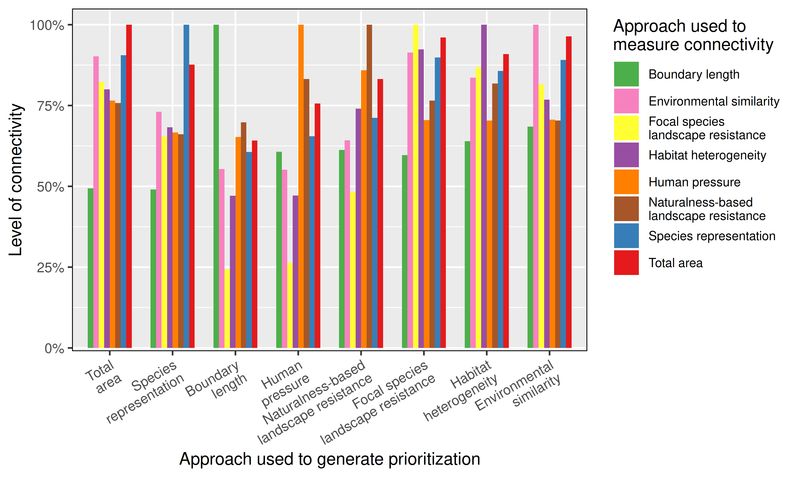
No obvious winner
Hanson et al. 2022 J. Appl. Ecol

Slide 42
Make better conservation decisions by using…
1. Better algorithms
2. Cost-effective data
3. Reliable surrogates

Slide 43




jeffrey.hanson@uqconnect.edu.au
github.com/jeffreyhanson
jeffrey-hanson.com

Slide 44
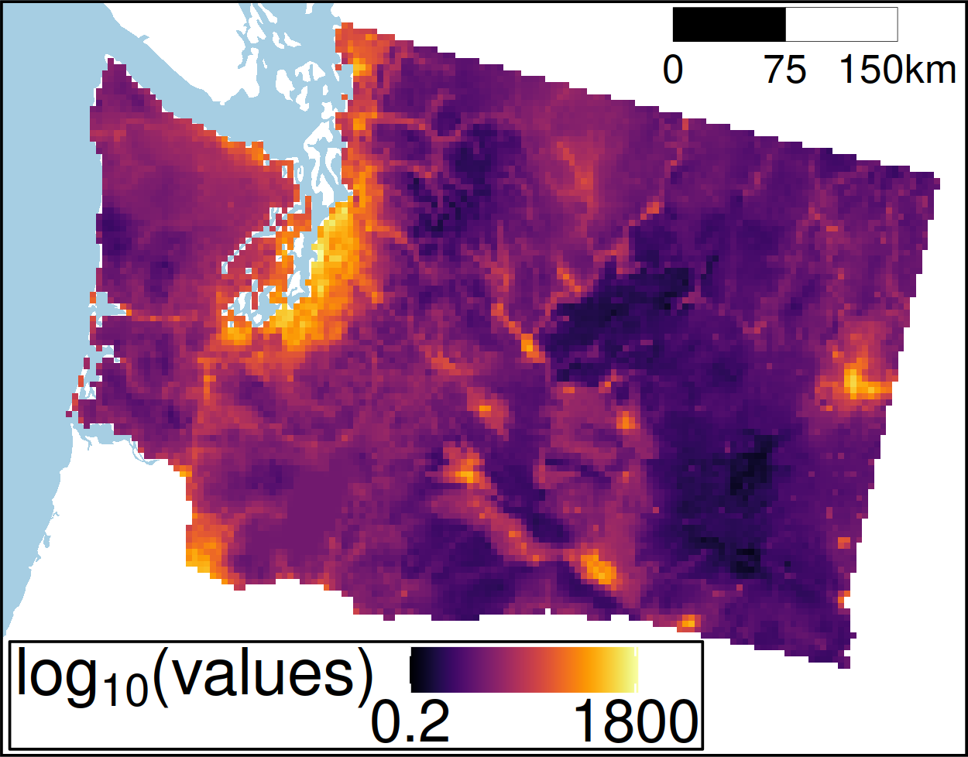
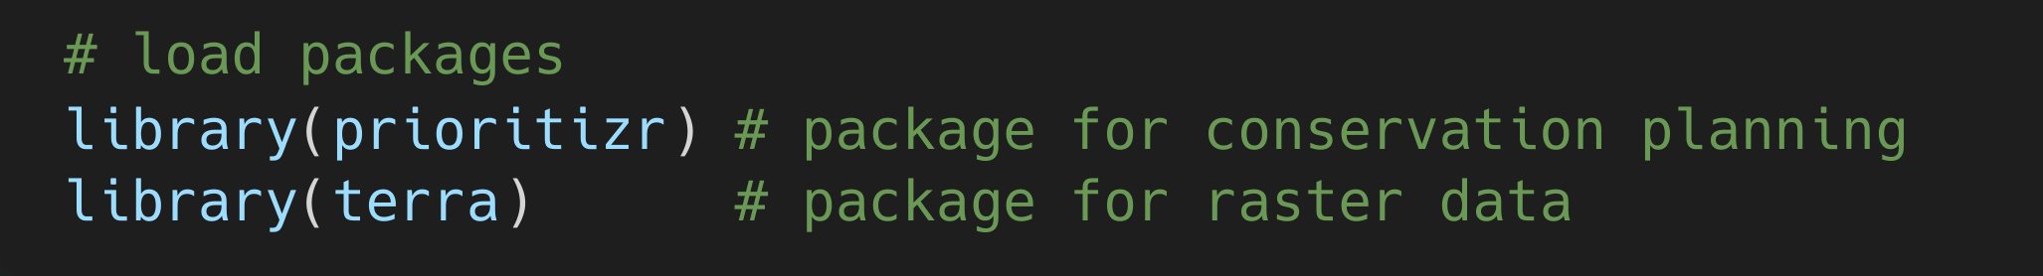
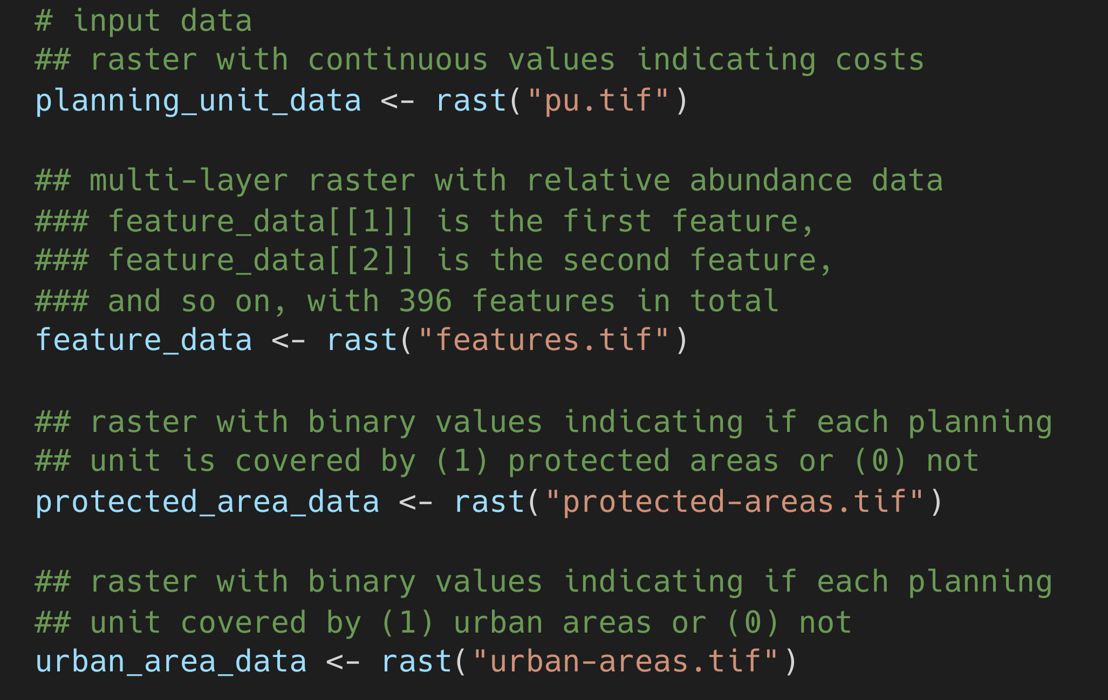
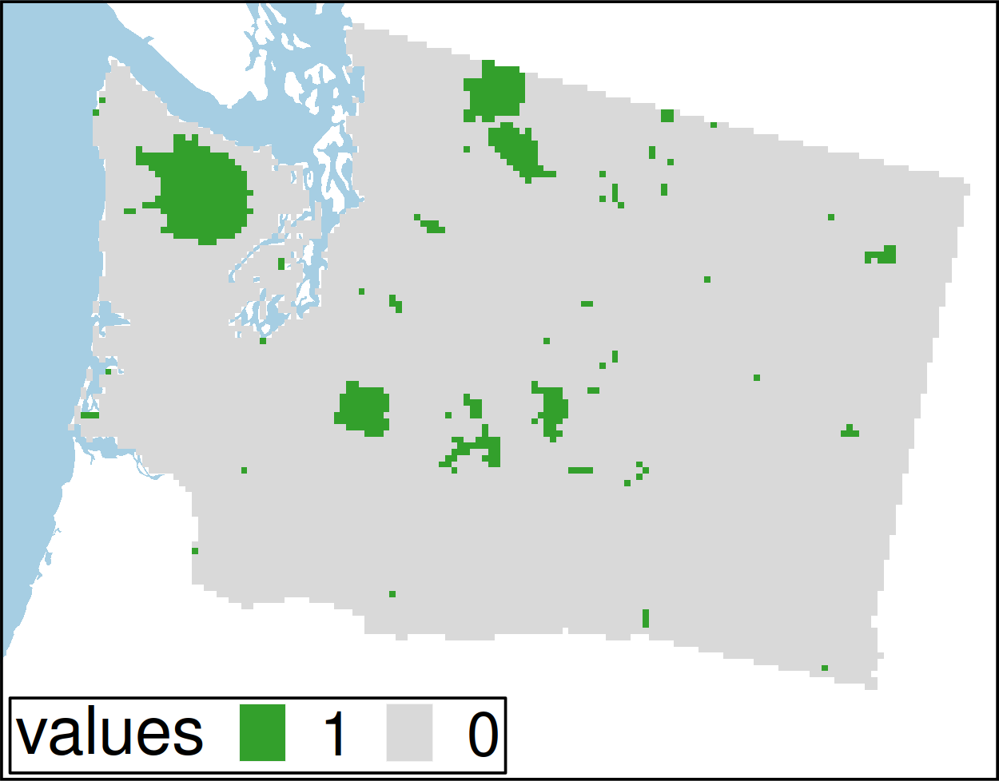
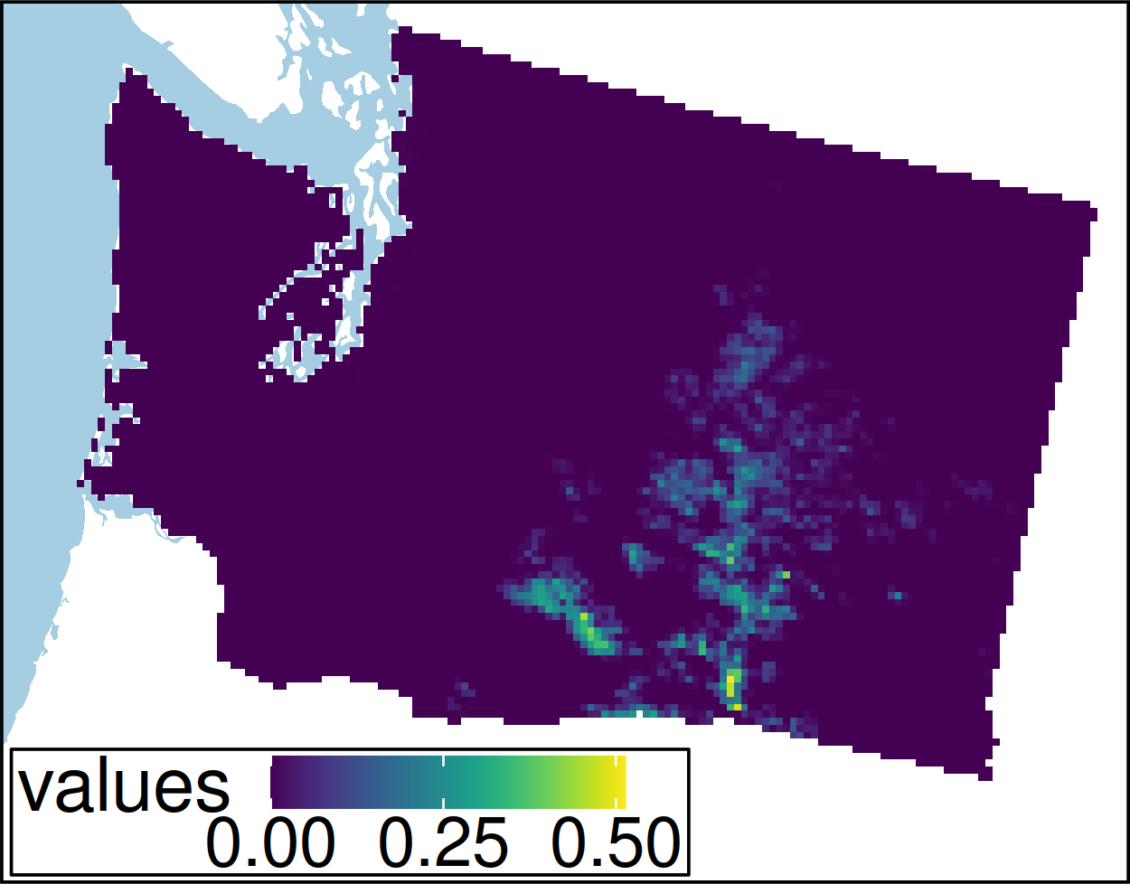
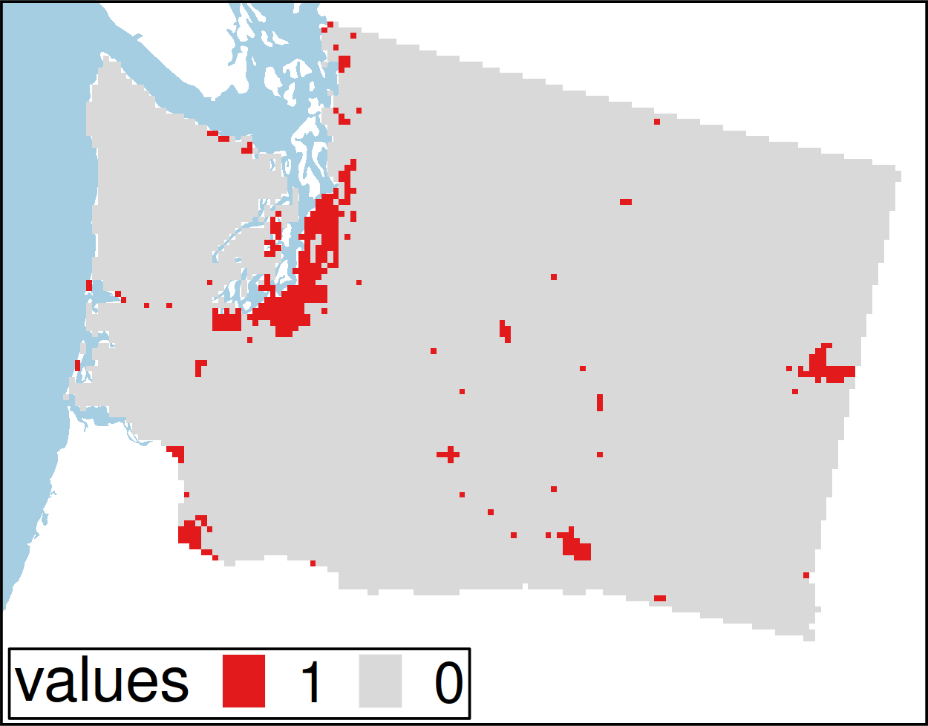
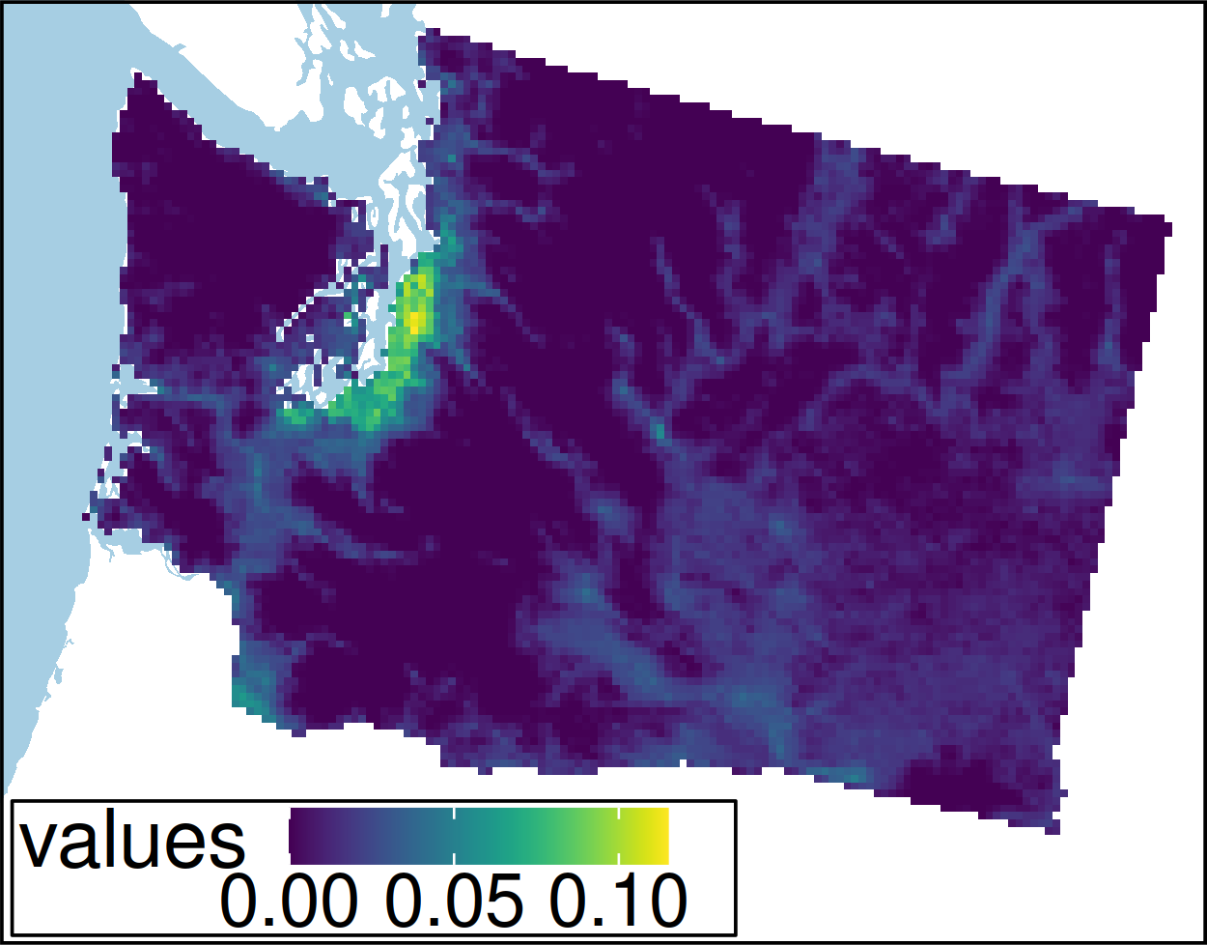
Worked example
Hanson et al. under review

Slide 45
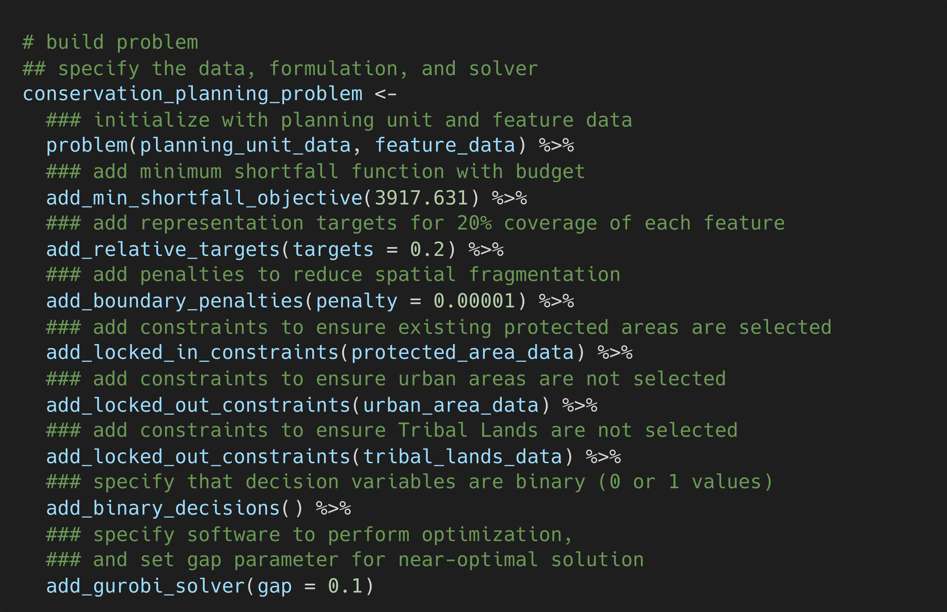
Hanson et al. under review

Slide 46
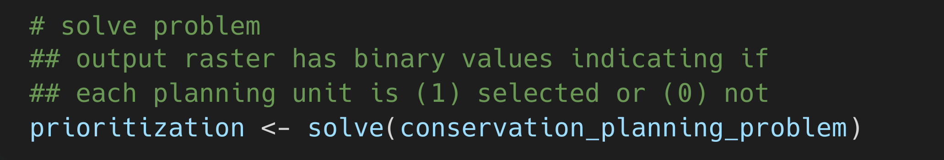
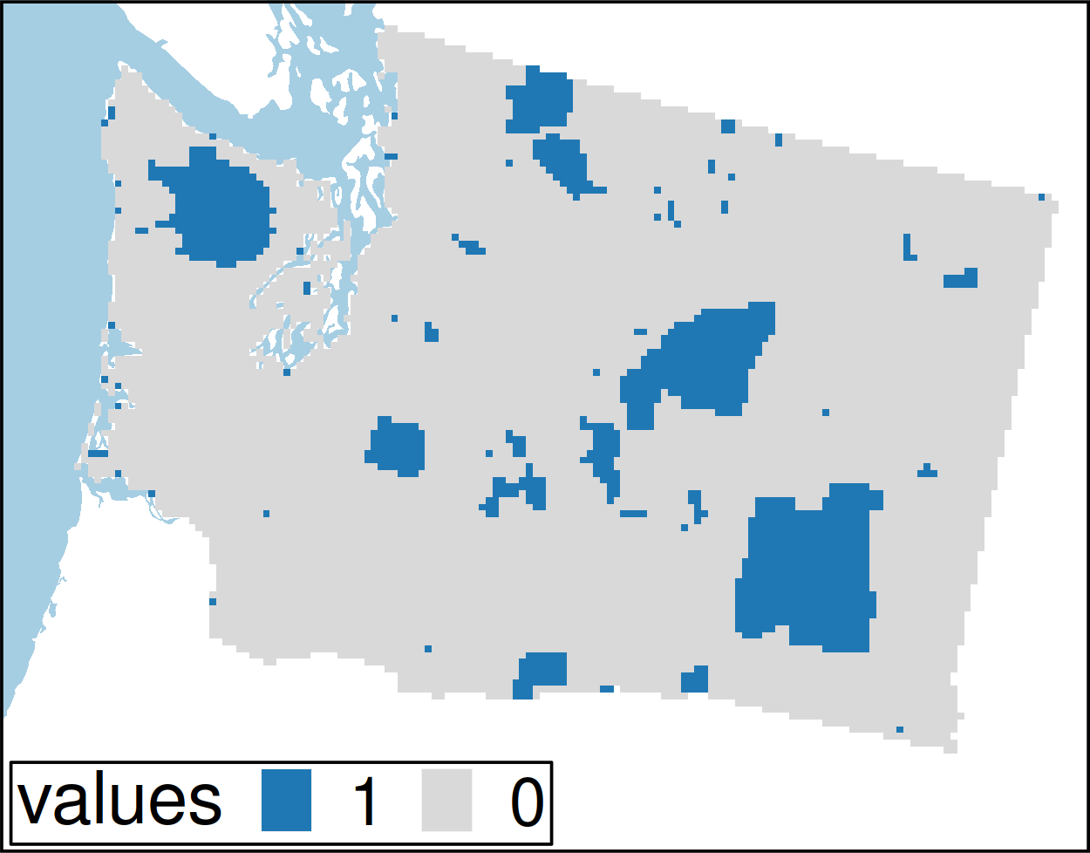
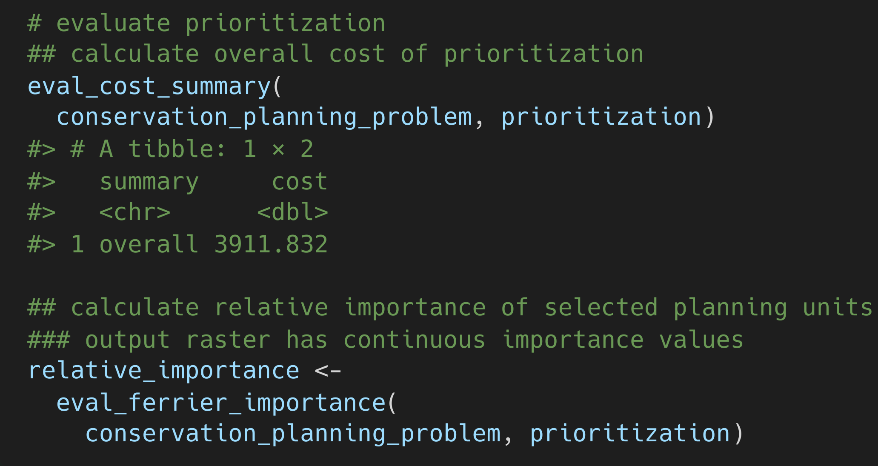
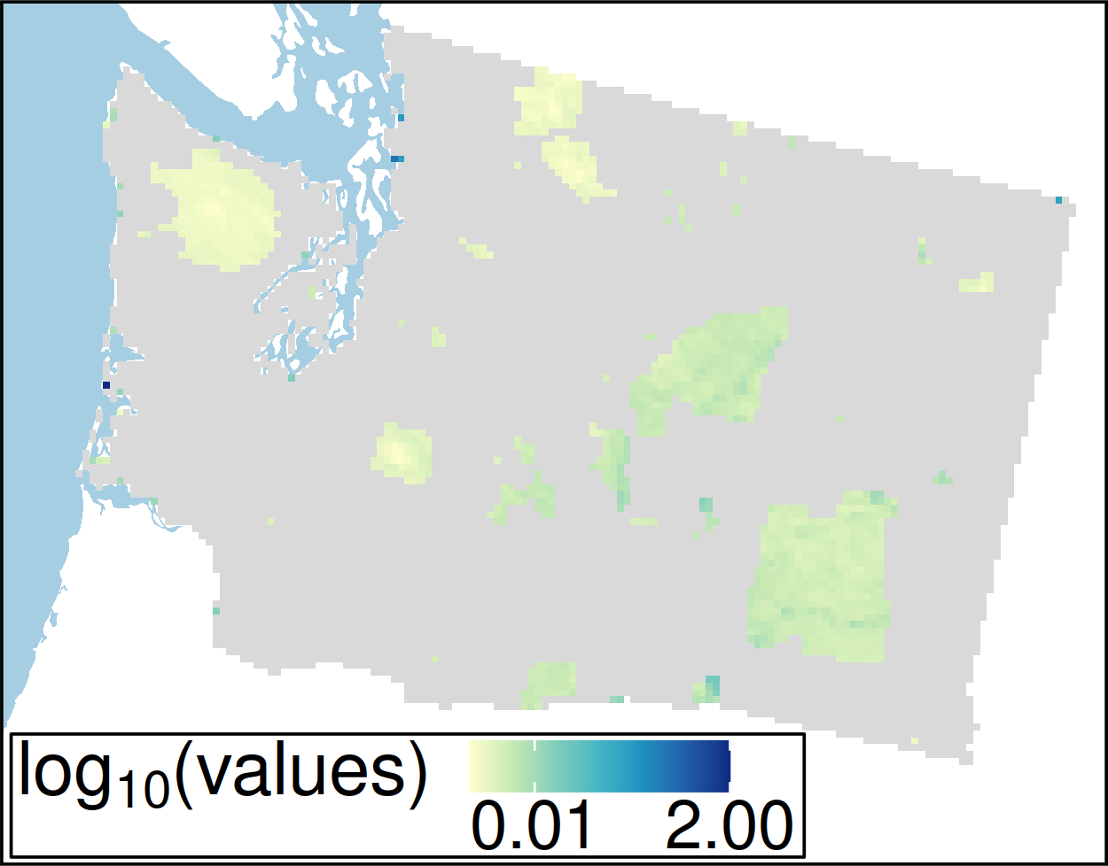
Hanson et al. under review

